Slide 1
Text Mining : Modeling Topics
GABRIEL CARESTIA
Thomas FERON
Notes:
<number>

Slide 2
Introduction
Summary
Information Retrieval
Last week's reminder
Latent Semantic Indexing
Singular value decomposition
Probabilistic Topic Models
Mixture of Unigrams Model
Probabilistic Latent Semantic Indexing
Latent Dirichlet Allocation
Exemples
Application : "A Correlated Topic Model of Science"
Bibliography
<number>
Notes:
<number>

Slide 3
But first a quick overview
We have 3 complexity level that make natural language text so rich :
Individual words are composed of letters (text morphology)
Words are pieced together to reflect syntactic structure (syntax)
All pieces collaborate to express meaning (semantic)
All topic models are based on the same assumption :
A document consists of several topics
Each topics consists of a collection of words
<number>

Slide 4
Some applications considering topical information :
Document retrieval (LSA)
Topic Tracking
Event Detection
Document Classification
Language Modeling
Machine Translation
…
<number>

Slide 5
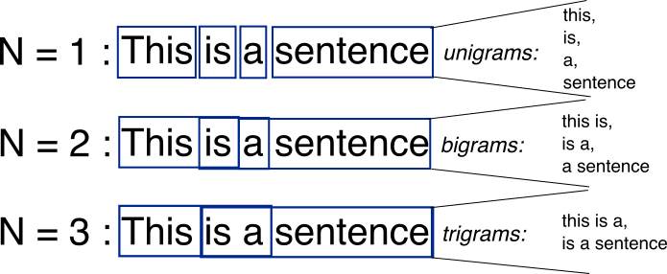
Relationships between words : N-Grams
Tokenize by pairs of adjacent words : extending the BOW
<number>
Notes:
Mais si on fait du 2-Grams, on va garder quand même les colonnes avec les silples token donc notre matrice va vite exploser en terme de taille !
<number>

Slide 6
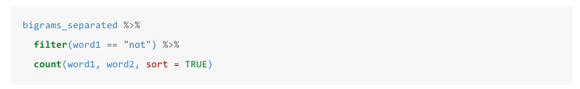
Using Bigrams to provide context in sentiment analysis
For exemple : « I’m not happy and I don’t like it »
<number>
Notes:
Si on utilise des unigrams on ne sera jamais conscient de la négation ! Avec bigrams, on peut voir le « not » précédant un adjectif !
<number>

Slide 7
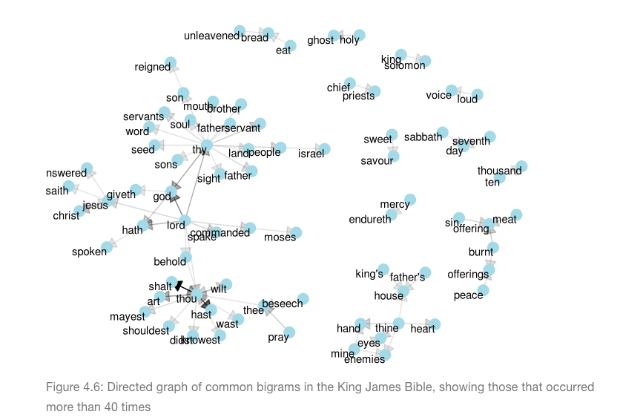
Visualizing bigrams in the Bible
<number>
Notes:
Bigrams de la bible par King James (uniquement les bigrams qui apparaissent plus de 40 fois)
<number>

Slide 8
Adding bigrams : the sparsity problem
Most of the cells in our matrix well be equal to 0 because most of the documents are not going to share the same bi-grams !
« There is no free lunch in computational science »
LSA
<number>
Notes:
Notre matrice peut vite être rempli à 99,99% de 0 !
<number>

Slide 9
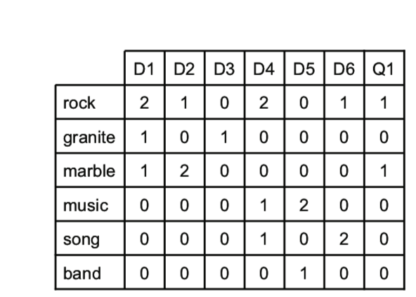
The Vector Space Model
Algebric model for representing text documents as vectors of identifiers
<number>
Notes:
En gros le Vector Space Model permet de contrer l’explosion de dimensionalité via LSA et SVD !
<number>

Slide 10
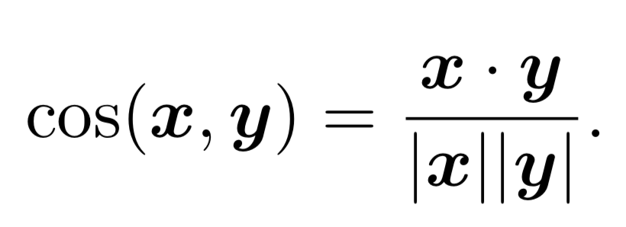
The Vector Space Model
<number>
Notes:
En gros le Vector Space Model permet de contrer l’explosion de dimensionalité via LSA et SVD !
Intuitivement on voit que doc 1 et 3 ont plus de ressemblance, doc 2 et 1 beaucoup moins!
<number>

Slide 11
Using Latent Semantic Analysis (LSA)
Why using LSA? To analyse relationships between a set of documents.
The idea : project documents to a lower-dimensional semantic space and causes documents with similar topical content to be close to one another in the resulting space.
In particular, two documents which share no terms with each other directly, but which do share many terms with third document, will end up being similar in the projected space.
<number>
Notes:
L’idée est de dire qu’il existe une sorte de loi mathématque, une loi de distribution (hypothèse de distribution) et que donc des mots dont le sens est proche vont apparaître dans une même région de texte.
<number>

Slide 12

<number>

Slide 13
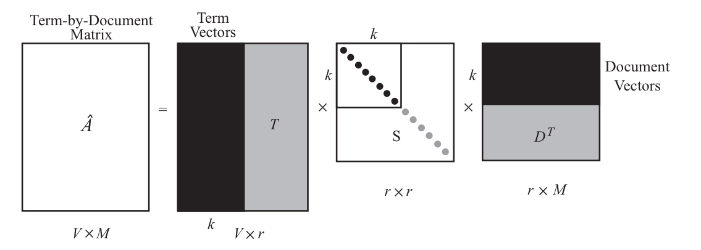
The maths behind LSA : SVD (singular value decomposition)
Understanding SVD : factorization of our Matrix A
<number>
Notes:
X est ma matrice décrit la fréquence du terme i dans le document j.
<number>

Slide 14
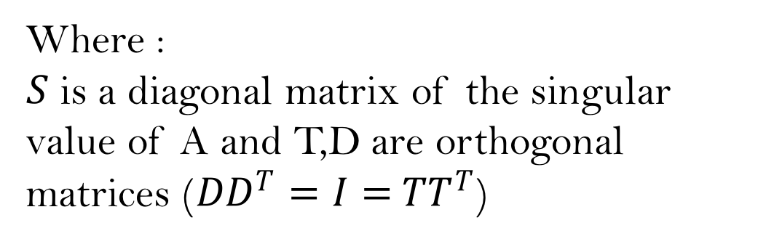
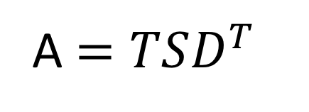
The maths behind LSA : SVD (singular value decomposition)
Understanding SVD :
We can decompose A as :
Where :
is a diagonal matrix of the singular value of A and T,D are orthogonal matrices ()
A
<number>
Notes:
On fait ici une factorisation/décomposition de X en fait ! On a X, notre matrice pour laquelle les valeur de corps (K).
La matrice V contient un ensemble de vecteurs de base orthonormés de K^{n}, dits « d'entrée » ou « d'analyse » ;
La matrice U contient un ensemble de vecteurs de base orthonormés de K^{m}, dits « de sortie » ;
La matrice Σ contient dans ses coefficients diagonaux les valeurs singulières de la matrice M.
<number>

Slide 15
The maths behind LSA : SVD (singular value decomposition)
Understanding SVD : how to reduce dimenionality?
Â Where k is an hyperparameter
<number>
Notes:
On va garder les k colonne les plus intéressante et enlever le r-k qu’il reste ! On a donc une approximation de A qui est alors Â.
K représente le nombre de topic qu’on veut garder
R représente le degré de variation de la matrice A…
<number>

Slide 16
The maths behind LSA : SVD (singular value decomposition)
Understanding SVD
Main idea of LSA : to strip away most of dimensions and only keep those which capture the most variation in the document collection (typically, from |V| = hundreds of thousands to k = between 100 and 200).
<number>
Notes:
On fait ici une factorisation/décomposition de X en fait ! On a X, notre matrice pour laquelle les valeur de corps (K).
La matrice V contient un ensemble de vecteurs de base orthonormés de K^{n}, dits « d'entrée » ou « d'analyse » ;
La matrice U contient un ensemble de vecteurs de base orthonormés de K^{m}, dits « de sortie » ;
La matrice Σ contient dans ses coefficients diagonaux les valeurs singulières de la matrice M.
<number>

Slide 17
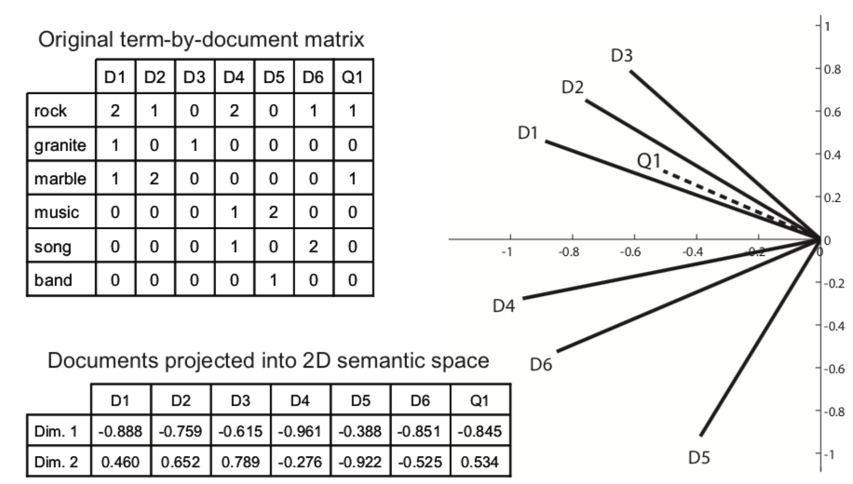
The maths behind LSA : SVD (singular value decomposition)
<number>
Notes:
On va garder les k colonne les plus intéressante et enlever le r-k qu’il reste ! On a donc une approximation de A qui est alors Â.
K représente le nombre de topic qu’on veut garder
R représente le degré de variation de la matrice A…
<number>

Slide 18
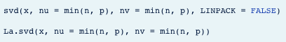
The maths behind LSA : SVD (singular value decomposition)
Understanding SVD using statisical interpretation :
Conculsion on SVD : Quite hard to understand ! But hopefully, we can use library to implement SVD without doing all the maths!
<number>
Notes:
<number>

Slide 19
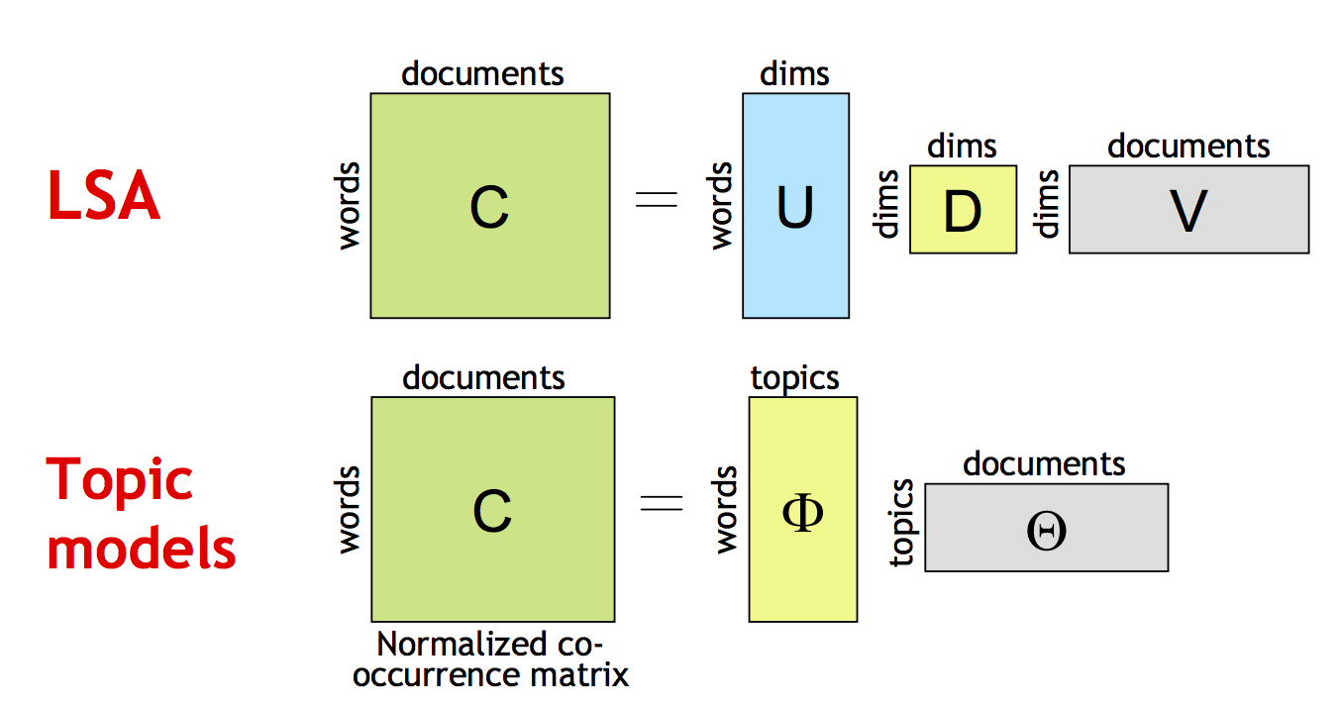
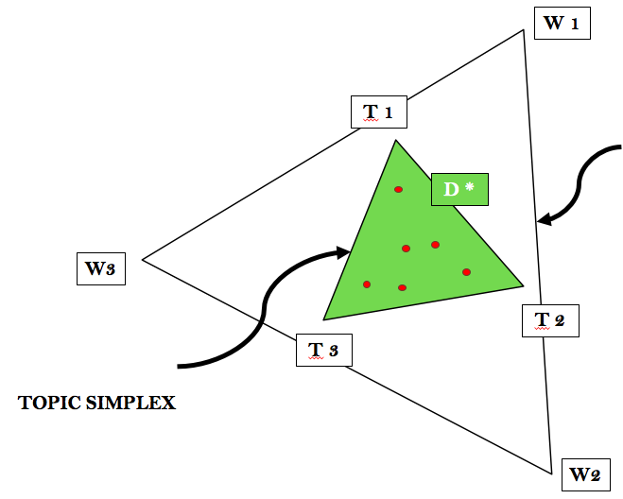
Probalistic topics model
<number>
Notes:
Alors que la LSA, qui découle de l'algèbre linéaire pour réduire les matrices des occurrences avec la méthode SVD,
l'approche probabiliste emploie un mélange de décompositions issues de l'analyse des classes latentes.
On obtient ainsi une approche plus souple, fondée sur les statistiques.
Probabilistic topic models are stochastic models for text documents that explicitly model topics.
Furthermore, they are generative
the models we describe in this section differ in terms of their complexity. In this section, we consider models in which the hidden topic attribute for a document is made explicit in the definition of the model. The models we discuss here feature a proper probabilistic framework, allowing access to a wide range of sophisticated techniques for training and inference.
The topics are not specified to the models a priori, but rather the models induce topics from collections of documents.
Once training on a document collection is completed, the model can be used to solve problems involving new documents.
For example, if we are interested in classifying new documents, we can obtain a probability distribution over the topics of each new document using the procedure of statistical inference.
Comparée à l'analyse sémantique latente simple, qui découle de l'algèbre linéaire pour réduire les matrices des occurrences (au moyen d'une décomposition en valeurs singulières), l'approche probabiliste emploie un mélange de décompositions issues de l'analyse des classes latentes. On obtient ainsi une approche plus souple, fondée sur les statistiques.
<number>

Slide 20
Probabilistic topics model : Key idea
<number>
Notes:
Hypothèse qu’un texte
<number>

Slide 21
Probabilistic topics model : Foundations
Hidden variables
Statistical inference
Generative processes
<number>

Slide 22
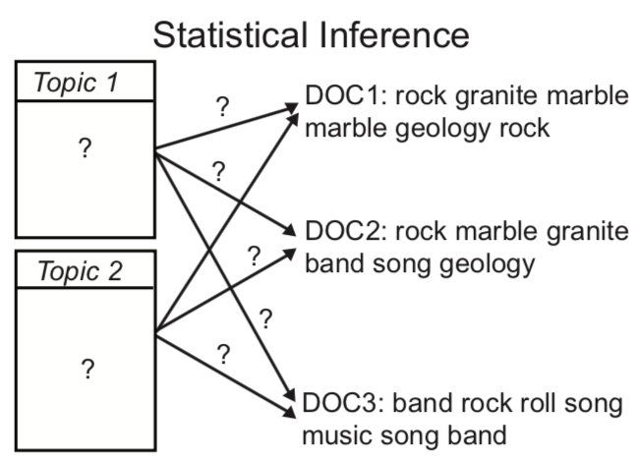
Probabilistic topics model : Hidden (Latent) Variables
<number>
Notes:
In this generative story, the topic is a “hidden” variable since it is not observed directly but can be observed indirectly through its effect on the words that are generated
Le sujet est la variable caché parce qu’elle n’est pas observable directement mais nous pouvons l’observer indirectement via ses effets sur les mots qui ont été générés.
<number>

Slide 23
Probabilistic topics model : Statistical Inference
<number>
Notes:
Statistical inference (invert): to know which topic model is most likely to have generated the data, it infers
 Probability distribution over words associated with each topic
 Distribution over topics for each document
 Topic responsible for generating each word
<number>

Slide 24
Probabilistic topics model : Generative Process
<number>
Notes:
Generative models: generating a document
 Choose a distribution over topics and the document length;
 For each word wi, choose a topic at random according to this distribution, and choose a word from the topicword distribution.
<number>

Slide 25
<number>
Notes:
<number>

Slide 26
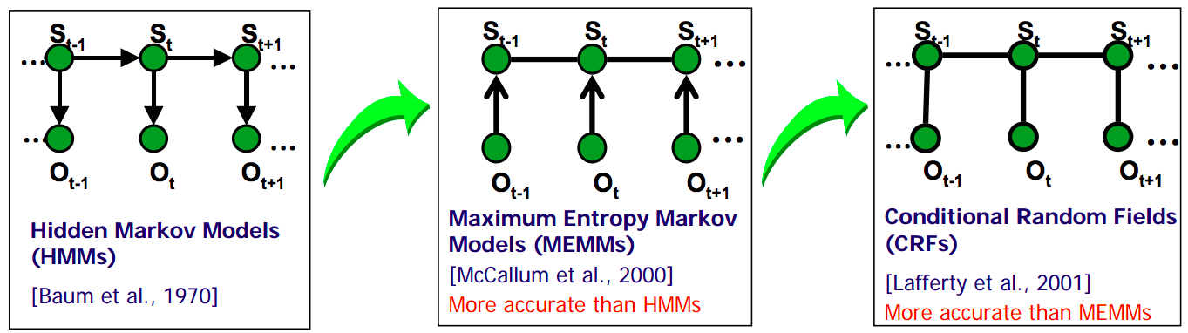
<number>

Slide 27
<number>

Slide 28
Probabilistic topics model : Time Evolution
Mixture of Unigrams Model (Nigam et al., 2000)
Probabilistic Latent Semantic Indexing (Hofmann,1999)
Latent Dirichlet Allocation (Blei et al., 2003)
<number>

Slide 29
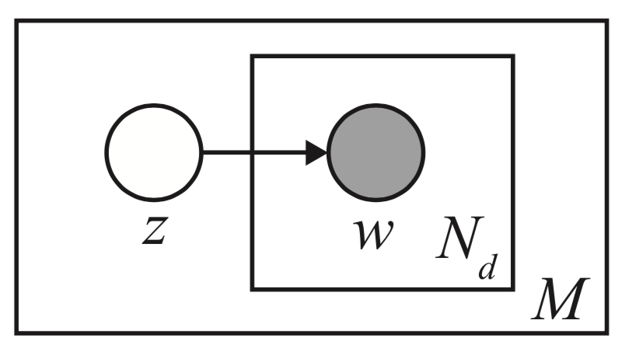
Mixture of Unigrams Model
(Nigam et al., 2000)
Simple, each document one topic (appropriate for supervised classification).
<number>
Notes:
1 sujet par document
Génération
<number>

Slide 30
The outer plate represents documents
<number>
Notes:
1 sujet par document
Génération
<number>

Slide 31
The inner plate represents words
The outer plate represents documents
<number>
Notes:
1 sujet par document
Génération
<number>

Slide 32
Each document has a single topic z
The inner plate represents words
The outer plate represents documents
<number>
Notes:
1 sujet par document
Génération
<number>

Slide 33
Each document has N_{d} words w generated from a multinomial conditioned on the topic.
Each document has a single topic z
The inner plate represents words
The outer plate represents documents
<number>
Notes:
1 sujet par document
Génération
<number>

Slide 34
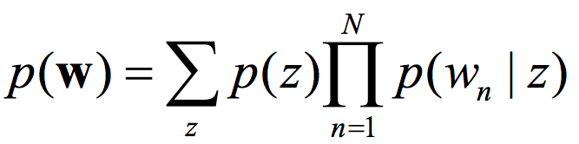
Mixture of Unigrams Model
Mixture of Unigrams Model
(Nigam et al., 2000)
<number>
Notes:
<number>

Slide 35
WORD 1
WORD SIMPLEX
WORD 3
WORD 2
<number>

Slide 36
WORD 1
TOPIC 1
WORD SIMPLEX
WORD 3
TOPIC 2
TOPIC 3
TOPIC SIMPLEX
WORD 2
<number>

Slide 37
W 1
Mixture of Unigrams Model
T 1
WORD SIMPLEX
W3
D 1
T 2
T 3
TOPIC SIMPLEX
W2
<number>

Slide 38
W 1
Mixture of Unigrams Model
T 1
WORD SIMPLEX
D *
W3
T 2
T 3
TOPIC SIMPLEX
W2
<number>
Notes:
Limitations:
1. a document can only contain a single topic.
2. the distributions have no priors and are assumed to be learned completely from data
<number>

Slide 39
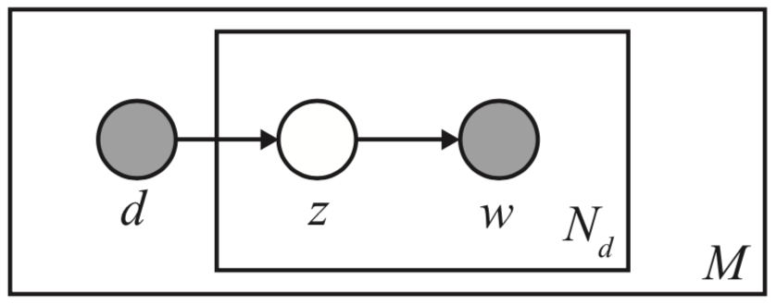
Probabilistic Latent Semantic Indexing
(Hofmann,1999)
<number>

Slide 40
The outer plate represents documents
<number>

Slide 41
The inner plate represents words
The outer plate represents documents
<number>

Slide 42
Each topic z is generated from a multinomial conditioned on the document d.
The inner plate represents words
The outer plate represents documents
<number>

Slide 43
Each topic z is generated from a multinomial conditioned on the document.
Each topic z is generated from a multinomial conditioned on the document d.
Each document has N_{d} words w generated from a multinomial conditioned on the topic z.
The inner plate represents words
The outer plate represents documents
<number>

Slide 44
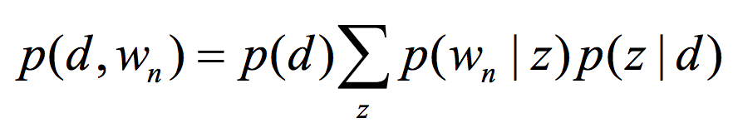
Probabilistic Latent Semantic Indexing
Probabilistic Latent Semantic Indexing
(Hofmann,1999)
<number>
Notes:
Probabilité conjointe
<number>

Slide 45
WORD 1
TOPIC 1
WORD SIMPLEX
WORD 3
TOPIC 2
TOPIC 3
TOPIC SIMPLEX
WORD 2
<number>

Slide 46
W 1
Probabilistic Latent Semantic Indexing
T 1
WORD SIMPLEX
D 1
W3
T 2
T 3
TOPIC SIMPLEX
W2
<number>

Slide 47
W 1
Probabilistic Latent Semantic Indexing
T 1
WORD SIMPLEX
W3
D *
T 2
T 3
TOPIC SIMPLEX
W2
<number>
Notes:
<number>

Slide 48
W 1
Probabilistic Latent Semantic Indexing
T 1
WORD SIMPLEX
W3
D *
T 2
T 3
TOPIC SIMPLEX
But…
W2
<number>
Notes:
 The model allows multiple topics in each document, but
 the possible topic proportions have to be learned from the document collection
 pLSI does not make any assumptions about how the mixture weights θ are generated, making it difficult to test the generalizability of the model to new documents.
 Topic distribution must be learned for each document in the collection # parameters grows with the number of documents (billion documents?).
<number>

Slide 49
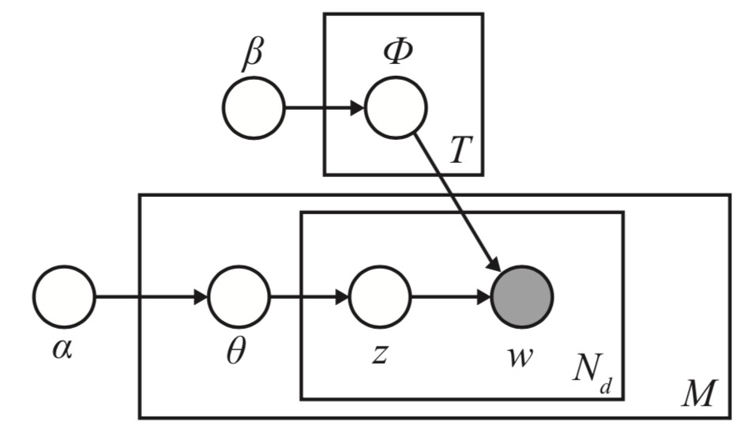
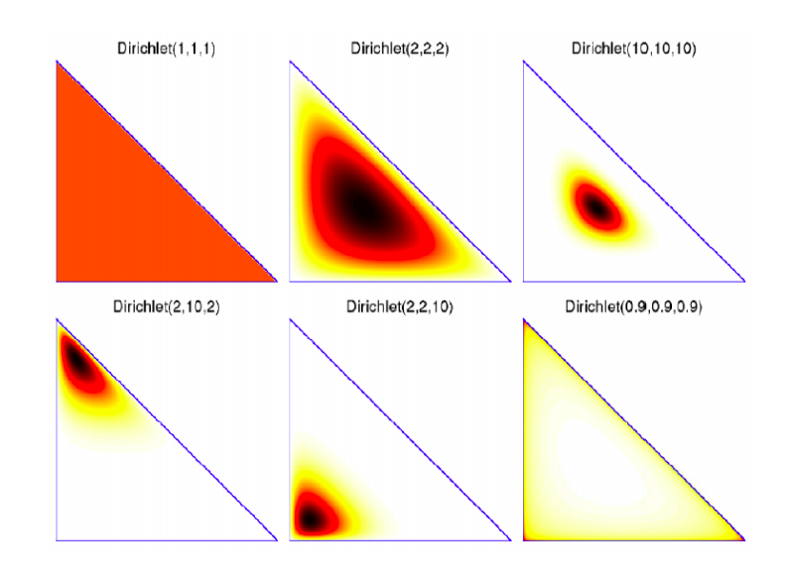
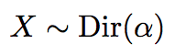
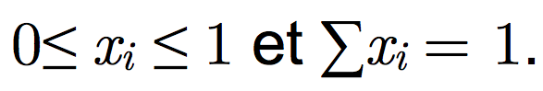
Latent Dirichlet Allocation
(Blei et al., 2003)
<number>
Notes:
LDA is a Bayesian version of pLSA.
Elle est vue comme la généralisation multinomiale de la loi bêta.
X est un vecteur aleatoire avec elements 0≤ xi ≤ 1 et ∑xi = 1. X ∼ Dir(α)
<number>

Slide 50
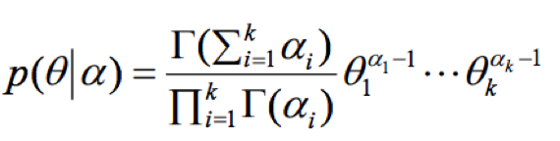
Latent Dirichlet Allocation
(Blei et al., 2003)
<number>
Notes:
LDA is a Bayesian version of pLSA.
Elle est vue comme la généralisation multinomiale de la loi bêta.
X est un vecteur aleatoire avec elements 0≤ xi ≤ 1 et ∑xi = 1. X ∼ Dir(α)
<number>

Slide 51
Latent Dirichlet Allocation
(Blei et al., 2003)
LDA models documents by assuming a document is composed by a mixture of hidden topics and that each topic consists of a probability distribution over words.
<number>
Notes:
LDA is a Bayesian version of pLSA.
Elle est vue comme la généralisation multinomiale de la loi bêta.
X est un vecteur aleatoire avec elements 0≤ xi ≤ 1 et ∑xi = 1. X ∼ Dir(α)
<number>

Slide 52
The outer plate represents documents
<number>
Notes:
LDA is a Bayesian version of pLSA.
Elle est vue comme la généralisation multinomiale de la loi bêta.
X est un vecteur aleatoire avec elements 0≤ xi ≤ 1 et ∑xi = 1. X ∼ Dir(α)
<number>

Slide 53
The inner plate represents words
The outer plate represents documents
<number>
Notes:
LDA is a Bayesian version of pLSA.
Elle est vue comme la généralisation multinomiale de la loi bêta.
X est un vecteur aleatoire avec elements 0≤ xi ≤ 1 et ∑xi = 1. X ∼ Dir(α)
<number>

Slide 54
The hyperparameter α is a parameter of a Dirichlet distribution over the topic that give a vector θ of topic proportions
The inner plate represents words
The outer plate represents documents
<number>
Notes:
LDA is a Bayesian version of pLSA.
Elle est vue comme la généralisation multinomiale de la loi bêta.
X est un vecteur aleatoire avec elements 0≤ xi ≤ 1 et ∑xi = 1. X ∼ Dir(α)
<number>

Slide 55
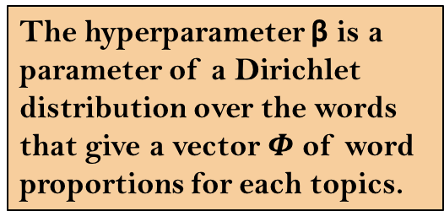
The hyperparameter β is a parameter of a Dirichlet distribution over the words that give a vector of word proportions for each topics.
The hyperparameter α is a parameter of a Dirichlet distribution over the topic that give a vector θ of topic proportions
The inner plate represents words
The outer plate represents documents
<number>
Notes:
LDA is a Bayesian version of pLSA.
Elle est vue comme la généralisation multinomiale de la loi bêta.
X est un vecteur aleatoire avec elements 0≤ xi ≤ 1 et ∑xi = 1. X ∼ Dir(α)
<number>

Slide 56
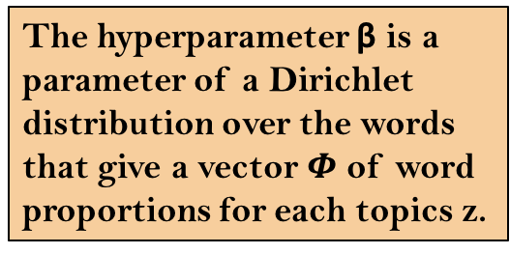
The hyperparameter β is a parameter of a Dirichlet distribution over the words that give a vector of word proportions for each topics z.
Each topic z is generated from a multinomial conditioned on the vector θ
The hyperparameter α is a parameter of a Dirichlet distribution over the topic that give a vector θ of topic proportions for each document.
The inner plate represents words
The outer plate represents documents
<number>
Notes:
LDA is a Bayesian version of pLSA.
Elle est vue comme la généralisation multinomiale de la loi bêta.
X est un vecteur aleatoire avec elements 0≤ xi ≤ 1 et ∑xi = 1. X ∼ Dir(α)
<number>

Slide 57
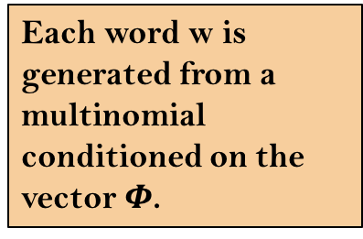
The hyperparameter β is a parameter of a Dirichlet distribution over the words that give a vector of word proportions for each topics z.
Each word w is generated from a multinomial conditioned on the vector .
Each topic z is generated from a multinomial conditioned on the vector θ
The hyperparameter α is a parameter of a Dirichlet distribution over the topic that give a vector θ of topic proportions for each document.
The inner plate represents words
The outer plate represents documents
<number>
Notes:
LDA is a Bayesian version of pLSA.
Elle est vue comme la généralisation multinomiale de la loi bêta.
X est un vecteur aleatoire avec elements 0≤ xi ≤ 1 et ∑xi = 1. X ∼ Dir(α)
<number>

Slide 58
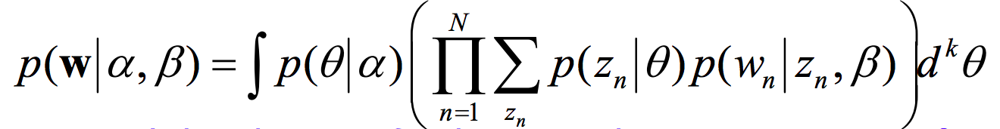
Latent Dirichlet Allocation
Latent Dirichlet Allocation
(Blei et al., 2003)
<number>

Slide 59
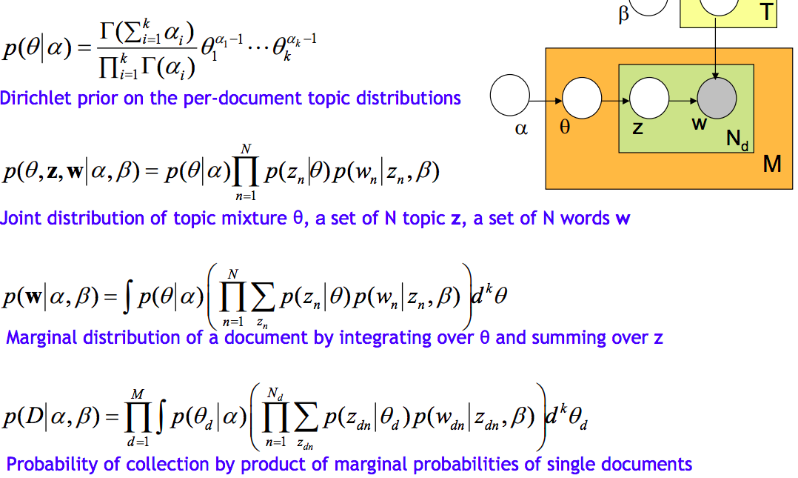
Latent Dirichlet Allocation
(Blei et al., 2003)
<number>

Slide 60
WORD 1
TOPIC 1
WORD SIMPLEX
WORD 3
TOPIC 2
TOPIC 3
TOPIC SIMPLEX
WORD 2
<number>

Slide 61
W 1
Latent Dirichlet Allocation
T 1
WORD SIMPLEX
W3
T 2
T 3
TOPIC SIMPLEX
W2
<number>

Slide 62
W 1
Latent Dirichlet Allocation
T 1
WORD SIMPLEX
D *
W3
T 2
T 3
TOPIC SIMPLEX
W2
<number>

Slide 63
W 1
Latent Dirichlet Allocation
T 1
WORD SIMPLEX
D *
W3
T 2
T 3
TOPIC SIMPLEX
W2
<number>

Slide 64
Latent Dirichlet Allocation
hierarchical Latent Dirichlet Allocation (hLDA)
Blei et al. [2004]
<number>

Slide 65
W 1
T 1
WORD SIMPLEX
W3
T 2
T 3
TOPIC SIMPLEX
W2
<number>

Slide 66
W 1
T 4
T 1
WORD SIMPLEX
W3
T 2
T 3
TOPIC SIMPLEX
W2
<number>

Slide 67
W 1
T 4
T 1
WORD SIMPLEX
D *
W3
T 2
T 3
TOPIC SIMPLEX
W2
<number>

Slide 68
Exemples
<number>

Slide 69
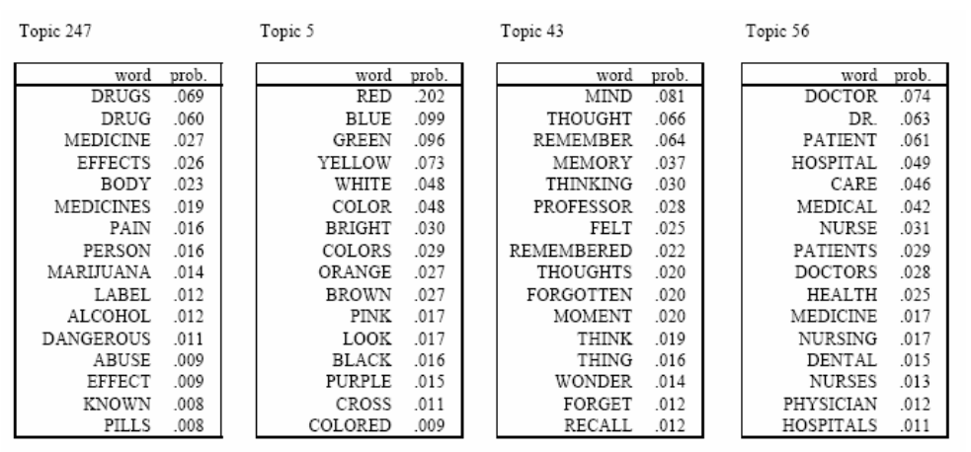

Exemples
TASA corpus, 37000 texts, 300 topics
<number>
Notes:
<number>

Slide 70

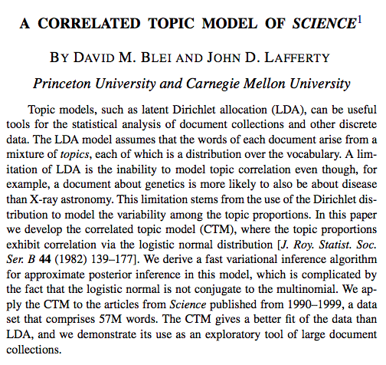
Application
<number>

Slide 71
Gimpel, K. (2006). Modeling topics. Inform. Retrieval, 5, 1-23.
Robinson, Julia Silge and David. Text Mining with R. Consulté le 10 octobre 2018. https://www.tidytextmining.com/topicmodeling.html.
« Vector Space Model ». Wikipedia, 18 juin 2018. https://en.wikipedia.org/w/index.php?title=Vector_space_model&oldid=846424051.
Knoth, Petr, et Phil Gooch. « An Introduction to Text Mining Research Papers », s. d., 28.
« Décomposition en valeurs singulières ». Wikipédia, 26 septembre 2018. https://fr.wikipedia.org/w/index.php?title=D%C3%A9composition_en_valeurs_singuli%C3%A8res&oldid=152516303.
Public repo for the Data Science Dojo YouTube tutorial series « Introduction to Text Analytics with R ».: datasciencedojo/IntroToTextAnalyticsWithR. R. 2017. Reprint, Data Science Dojo, 2018. https://github.com/datasciencedojo/IntroToTextAnalyticsWithR.
Thomas, David A. « Searching for Significance in Unstructured Data: Text Mining with Leximancer ». European Educational Research Journal 13, nº 2 (avril 2014): 235‑56. https://doi.org/10.2304/eerj.2014.13.2.235.
Blei, D. M., Ng, A. Y., & Jordan, M. I. (2003). Latent Dirichlet Allocation. Journal of Machine Learning Research, 3, 993-1022.
Blei, D. M., Griffiths, T. L., Jordan, M. I., & Tenenbaum, J. B. (2004). Hierarchical topic models and the nested Chinese restaurant process. In Advances in Neural Information Processing Systems 16. Cambridge, MA: MIT Press.
J. Allan. Topic Detection and Tracking - Event-based Information Organization. Kluwer Academic Publishers, 2002.
Latent Semantic Analysis and Topic Modeling: Roads to Text Meaning Hồ Tú Bảo Japan Advanced Institute of Science and Technology Vietnamese Academy of Science and Technology
Bibliography
<number>

